Slide 1

FPT University
Android programMing
Lesson 1
Version 1.0

Slide 2
Agenda
Android programming overview
Installation environment
Hello world
Creating AVD
Debug on real device

Slide 3
Android programming overview
Android is an open source and Linux-based Operating System was developed by the Open Handset Alliance led by Google
The first beta version of android ADK was released by Google in 2007

Slide 4
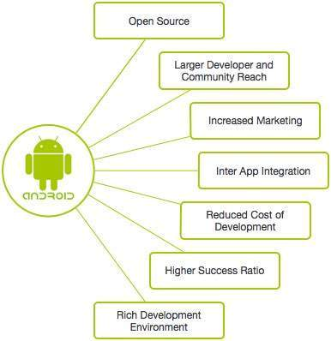
Android programming overview
Why Android ?

Slide 5
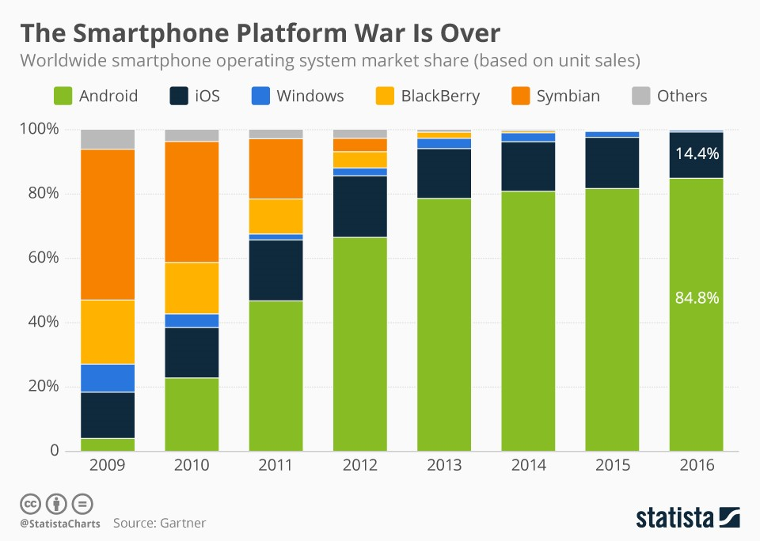
Android programming overview
Why Android ?

Slide 6
Android programming overview
Features of Android
UI & UX Connectivity Storage Messaging Web browser Multi-touch | Multi-tasking Resizable widgets Multi-Language GCM Wi-Fi Direct Android Beam
Notes:
1Beautiful UI Android OS basic screen provides a beautiful and intuitive user interface.
2Connectivity GSM/EDGE, IDEN, CDMA, EV-DO, UMTS, Bluetooth, Wi-Fi, LTE, NFC and WiMAX.
3Storage SQLite, a lightweight relational database, is used for data storage purposes.
4Media support H.263, H.264, MPEG-4 SP, AMR, AMR-WB, AAC, HE-AAC, AAC 5.1, MP3, MIDI, Ogg Vorbis, WAV, JPEG, PNG, GIF, and BMP.
5Messaging SMS and MMS
6Web browser Based on the open-source WebKit layout engine, coupled with Chrome's V8 JavaScript engine supporting HTML5 and CSS3.
7Multi-touch Android has native support for multi-touch which was initially made available in handsets such as the HTC Hero.
8Multi-tasking User can jump from one task to another and same time various application can run simultaneously.
9Resizable widgets Widgets are resizable, so users can expand them to show more content or shrink them to save space.
10Multi-Language Supports single direction and bi-directional text.
11GCM Google Cloud Messaging (GCM) is a service that lets developers send short message data to their users on Android devices, without needing a proprietary sync solution.
12Wi-Fi Direct A technology that lets apps discover and pair directly, over a high-bandwidth peer-to-peer connection.
13Android Beam A popular NFC-based technology that lets users instantly share, just by touching two NFC-enabled phones together.

Slide 7
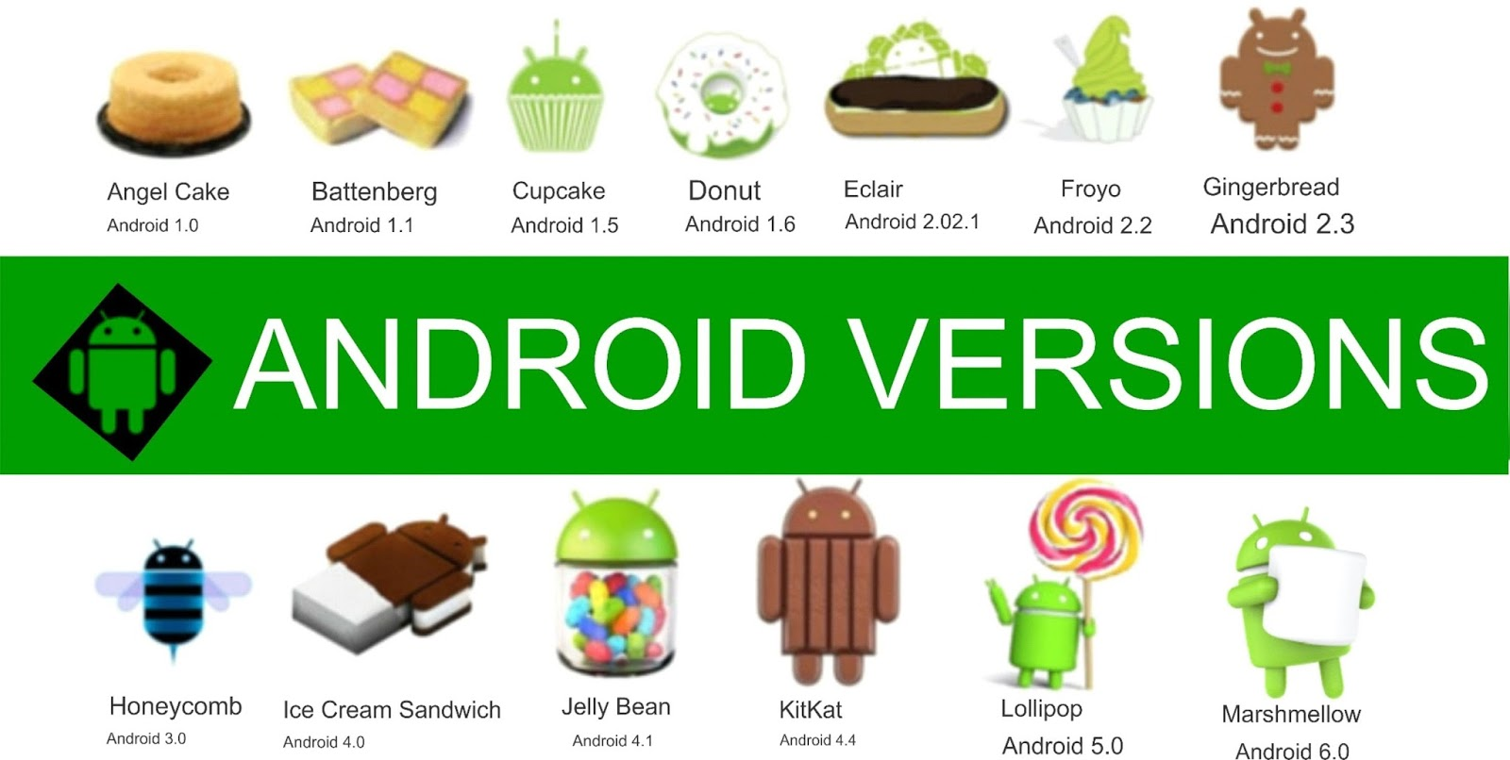
Android programming overview
Notes:
Nougat^{[15]}7.0 – 7.1.24.4August 22, 201624 – 25
Oreo^{[16]}8.0 – 8.14.10August 21, 201726 – 27
Pie^{[17]}9.04.4.107, 4.9.84, and 4.14.42August 6, 201828

Slide 8
Installation environment
System requirement https://developer.android.com/studio/#Requirements
Installing JDK https://www.oracle.com/technetwork/java/javase/downloads/jdk8-downloads-2133151.html
Installing Android Studio https://developer.android.com/studio/
Installing Additional Android SDK Packages
File | Settings | Appearance & Behavior | System Settings | Android SDK

Slide 9
Installation environment
Setting environment variables
System | Advanced System Settings | Environment Variables
Notes:
E:\Program\Android\sdk\platform-tools
E:\Program\Android\sdk\tools

Slide 10
Hello world
Create the 1st project
A Tour of the Android Studio User Interface

Slide 11
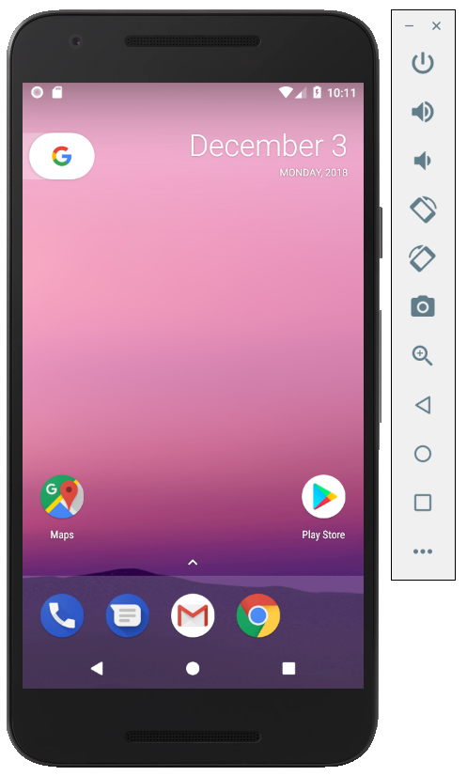
Creating AVD
What is AVD

Slide 12
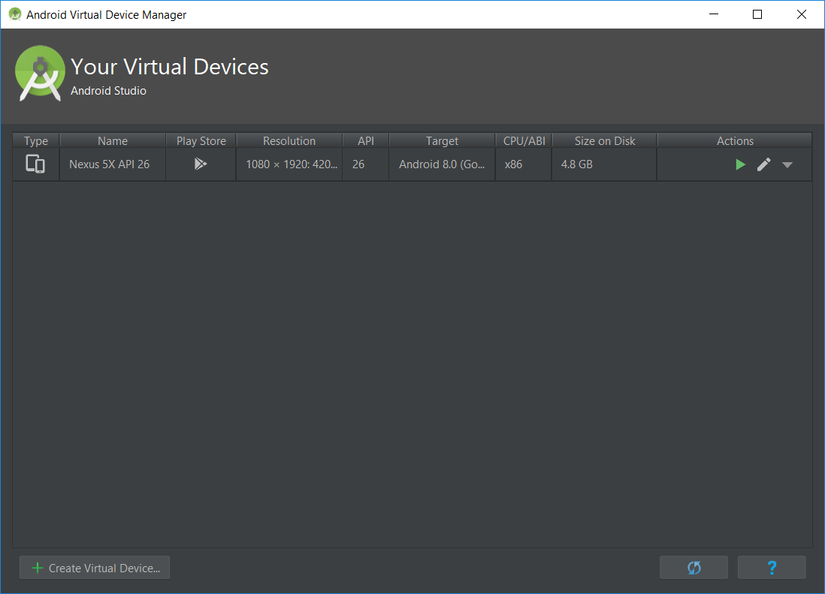
Creating AVD

Slide 13
Debug on real device
Android Debug Bridge (ADB)
Facilitate interaction between Android Studio and both AVD emulators and physical Android devices for the purposes of running and debugging applications
Where’s the ADB locate?
Android SDK platform-tools sub-directory

Slide 14
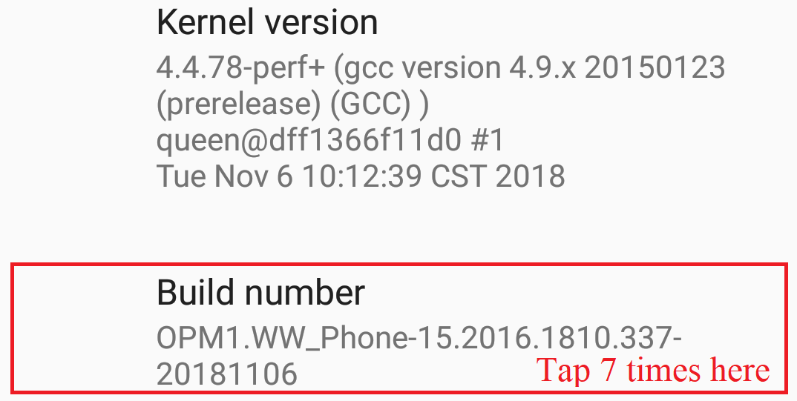
Debug on real device
Enable Developer Options

Slide 15
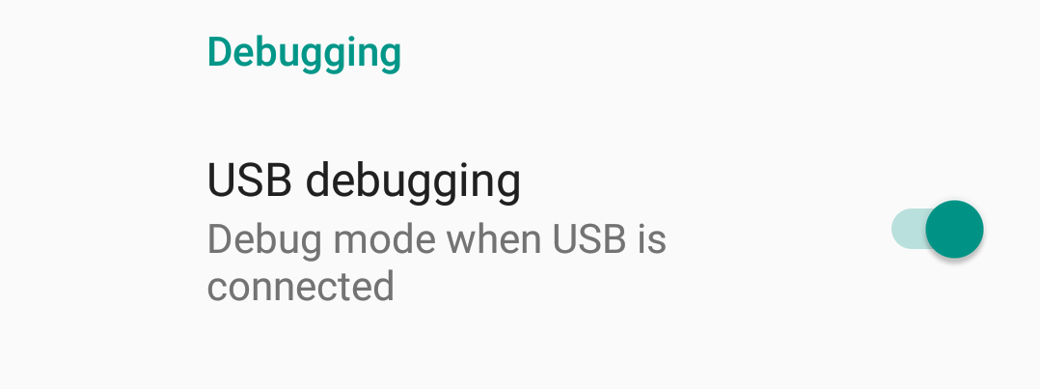
Debug on real device
Enable debugging mode

Slide 16
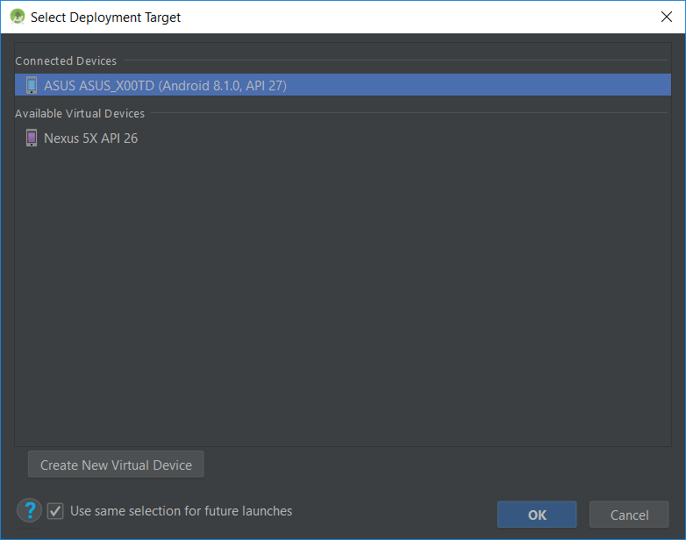
Debug on real device
Plugging and Testing

Slide 17

End of Lesson 1

Slide 18
Thank you!

